Slide 1
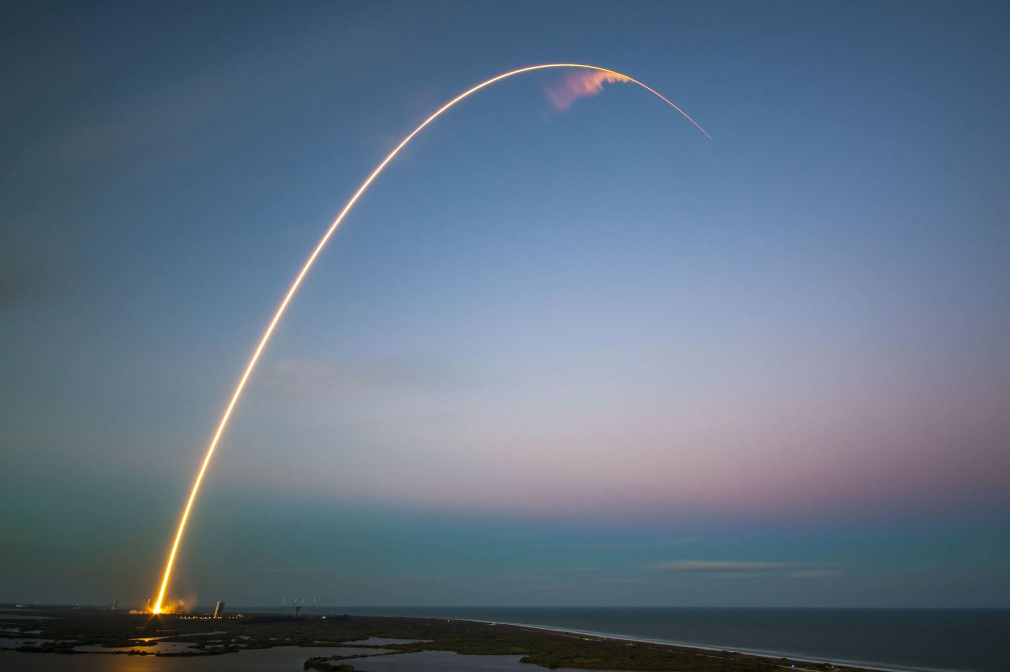
Tyee Rocketry Club
Coaches: Eugene Li, Varun Nair, Ishaan Makam
Mentor: Mr. Burke

Slide 2
TARC Overview
Different stages of competition
Same requirements for all teams
Washington DC Nationals
$2-3k cost per student
International competition in England
Free

Slide 3
Club Objectives
October - December:
Students will form teams of 5
Learn rocket construction techniques
Get familiar with computer simulations and CAD
January - April:
Students will start working on their TARC rocket
Goal is to qualify for DC nationals
April - May:
If students qualify for DC, they will start preparing for that
If not, we will introduce students to some more advanced rocketry projects such as using CFD and making their own flight computers
Hard limit of 15 students
Selection process

Slide 4
What we need from Students
Passionate about science and rocketry
Motivated and interested
No prior experience necessary
Time requirements:
October - December: 5:00-7:00 every Thursday, 9:00-12:00 Saturday twice a month
January - April: 5:00-7:00 every Tuesday and Thursday, 9:00-12:00 Saturday 3-4 times a month
4 strikes rule
Attendance, behavior, etc.

Slide 5
What we need from parents
Industry connections
Guest speakers, tours, etc.
Support for students
Weekly rotation for bringing meals to students
Driving and picking up students to launches
$400 non-refundable fee
More(Estimating 800+) if students make nationals

